Slide 1
Finding Stars Within a Virtual Maze
Team 1

Slide 2
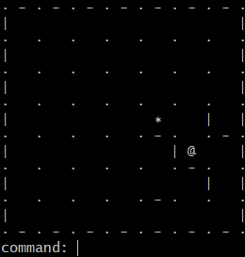
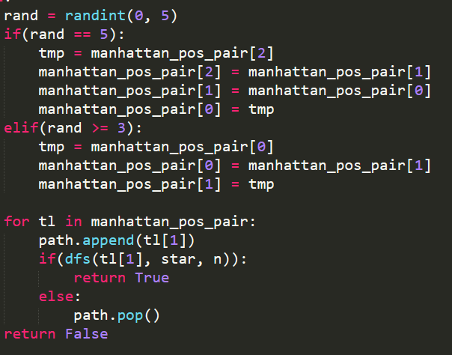
Our Game
2 players: one with computer (position and surrounding) + phone (bluetooth) as guider, one blindfolded as puppet
n * n maze with 3 * 3 visible range
Type ‘w’,’a’,’s’,’d’ to explore and find stars!
Randomized algorithm with backtracking to generate maze
Notes:
Talks about how the game processes, computer shows position of player and surroundings, phone for bluetooth communication,

Slide 3
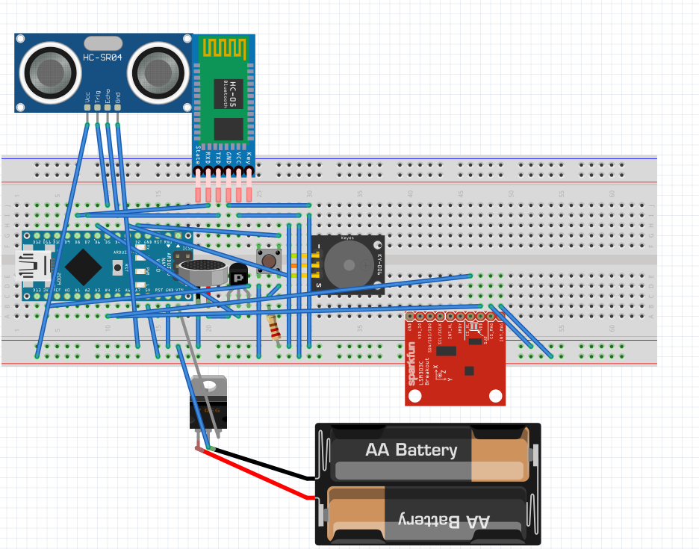
Our Circuit

Slide 4
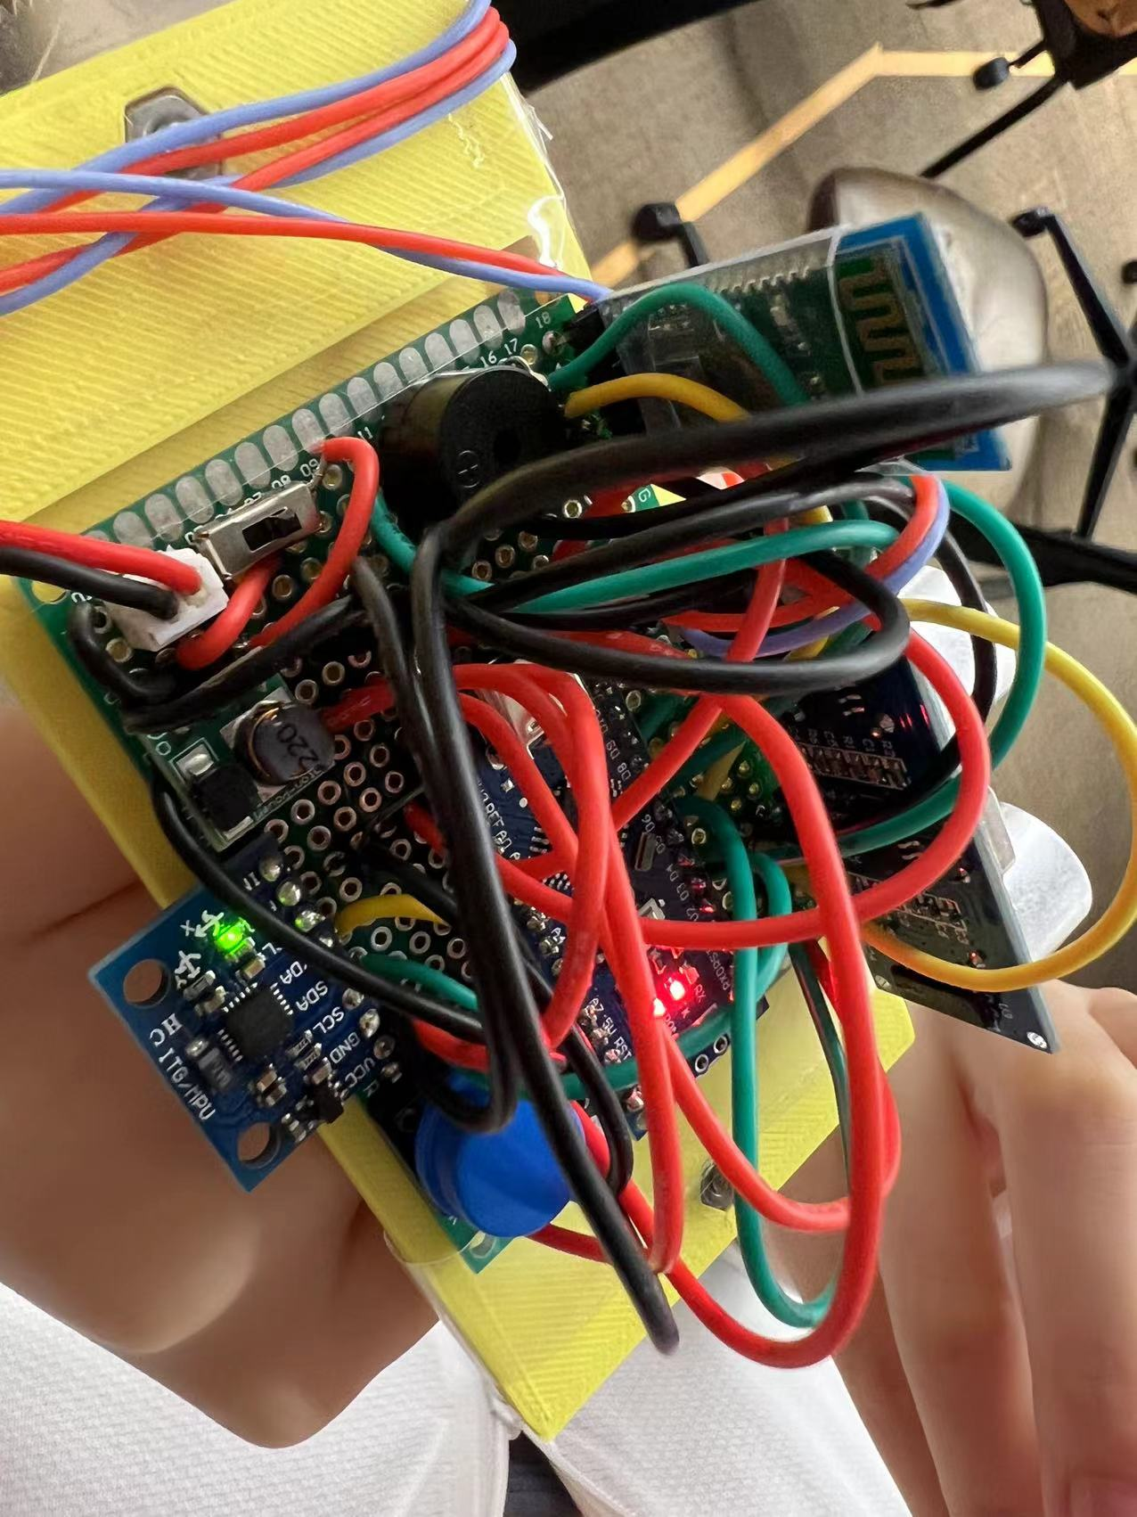
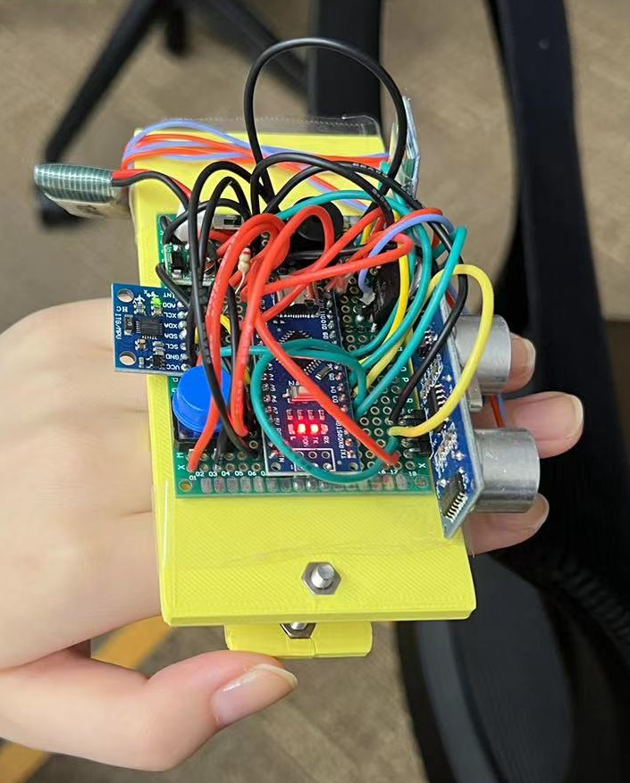

Slide 5
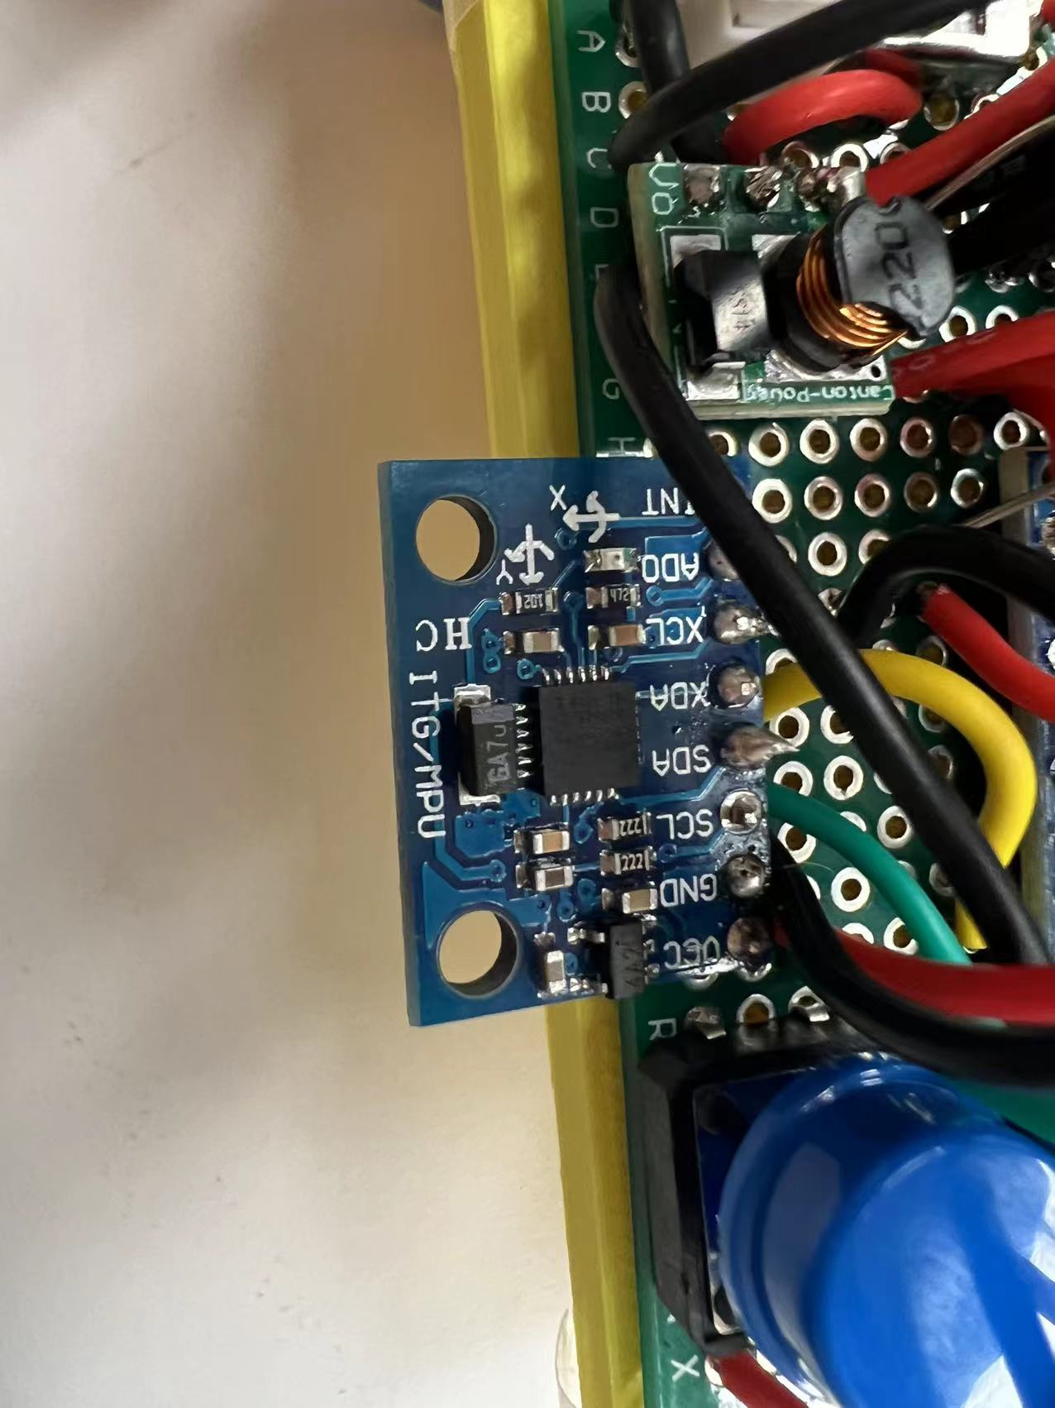
Accelerometer GY-521 - input
Communicates with Arduino using SCL (Serial Clock for the communication) and SDA (data transfer)
We took the second integral of acceleration to compute displacement.
Added automatic calibration despite difficulties.
Notes:
Now we manually update player position when we see them walk.

Slide 6
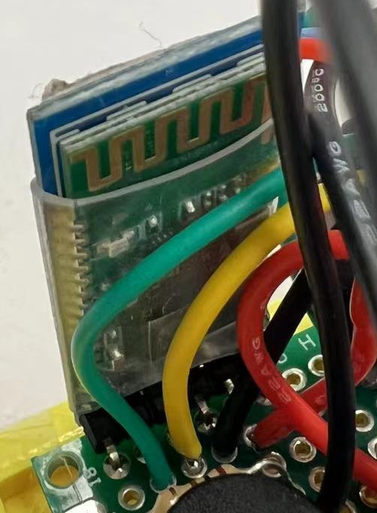
Bluetooth HC05 - input and output
Communication between players
Messages trigger LRA vibration, button status and position update (if accelerometer enabled)

Slide 7
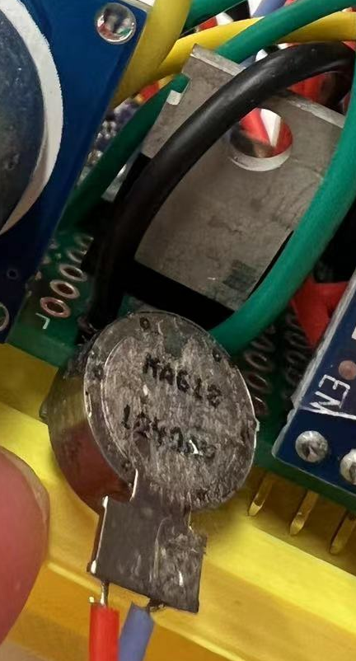
LRA with MOSFET - output
Vibrates in different ways depending on the command of the player using phone
Similar code as buzzer
MOSFET: same role as transistor (and technically transistor); do not require bias resistor; triggered by voltage not current

Slide 8
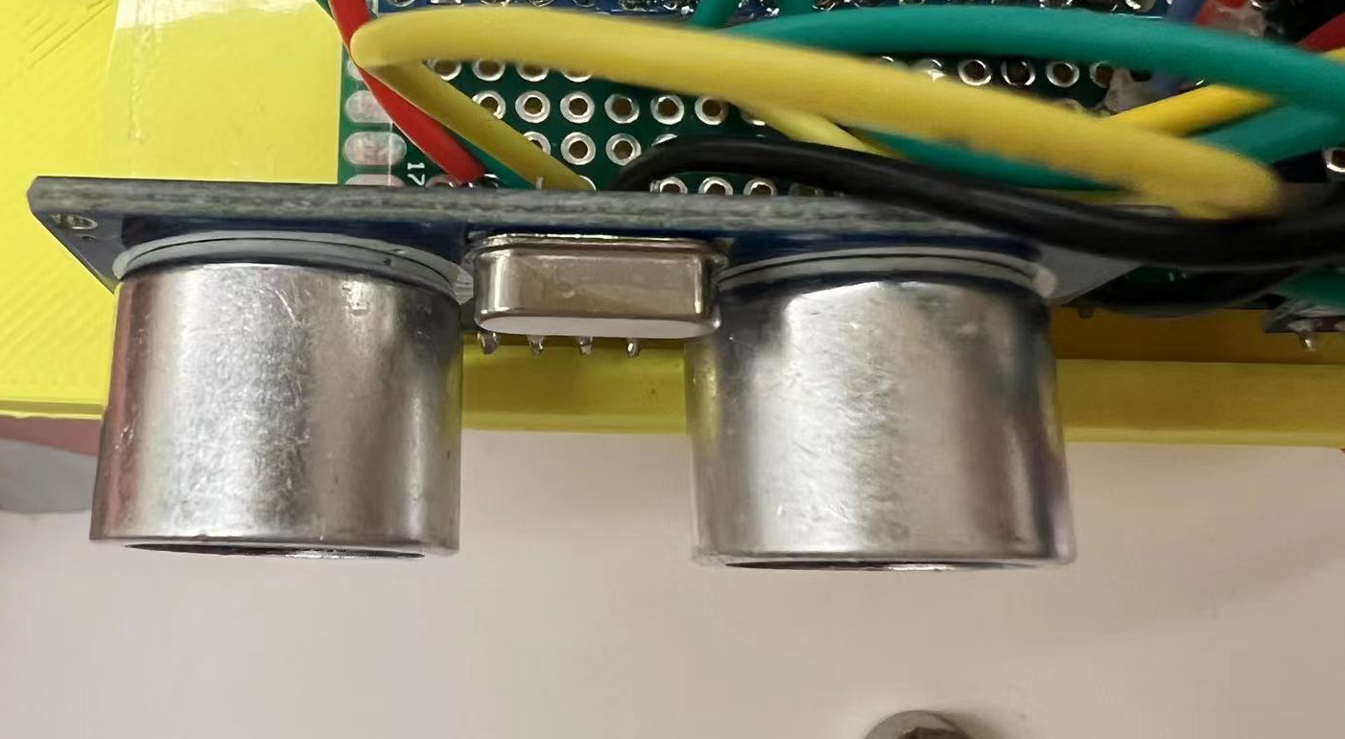
Ultrasound HC-SR04 - input
Distance detection to avoid collision
Use code from PID assignment

Slide 9
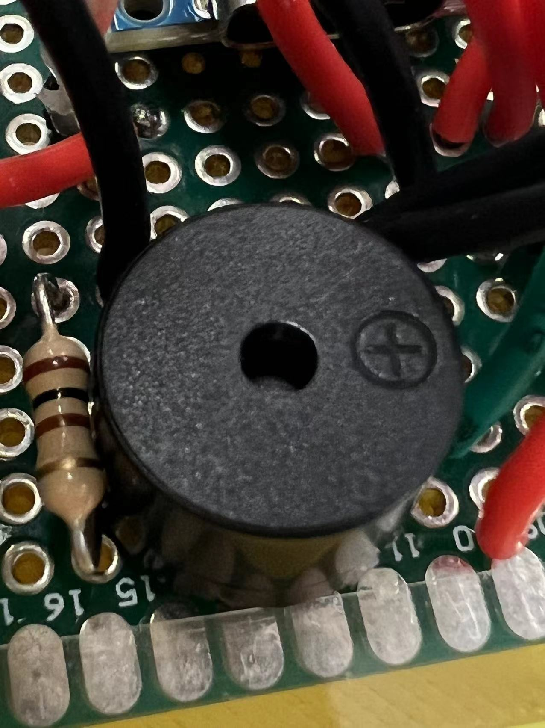
Buzzer - output
Makes low frequency noise is user is too close to wall
Plays victory tune

Slide 10
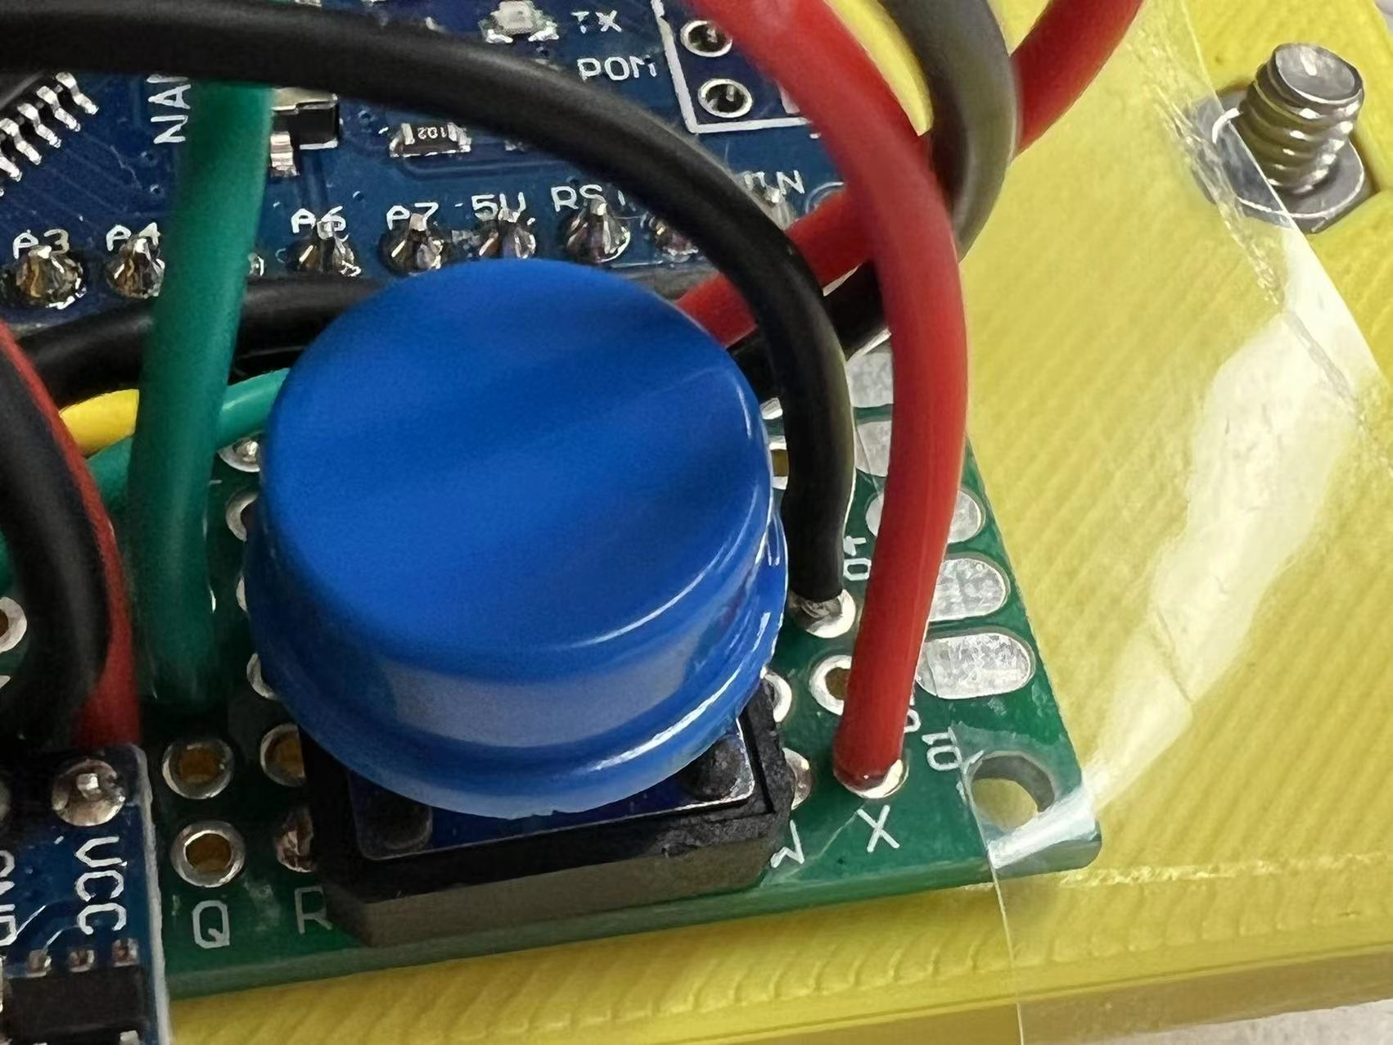
Button - Input
Pauses the game to allow player relocation
Each press triggers a bluetooth message indicating the pressed status

Slide 11
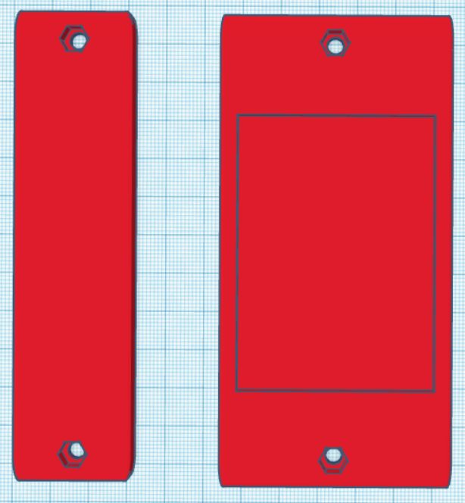
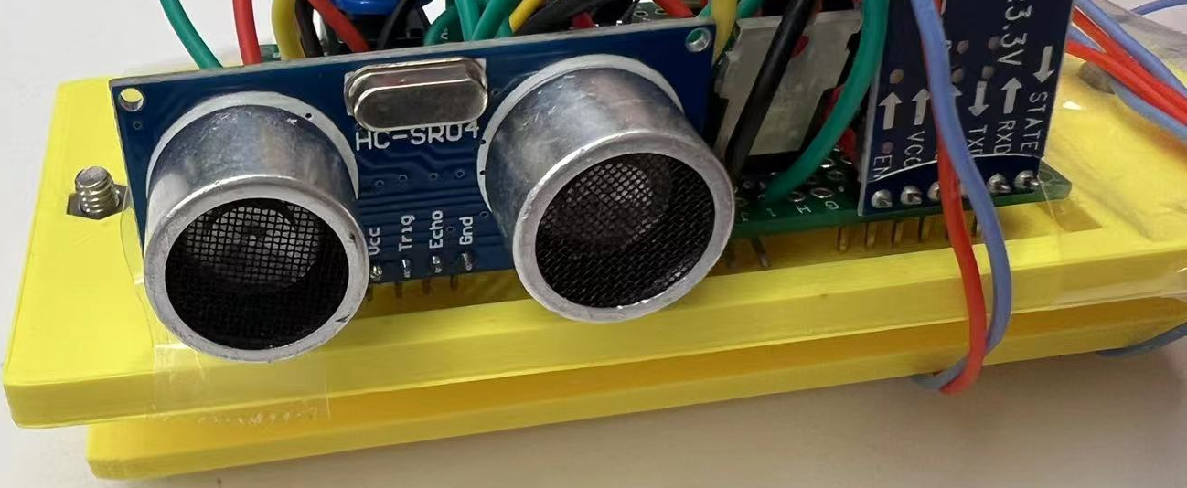
Wearable structure
3D printed structure with nut holders and screws

Slide 12
References
MPU6050 Module Pinout, Configuration, Features, Arduino Interfacing & Datasheet (components101.com)
https://electropeak.com/learn/interfacing-gy-521-mpu6050-3-axis-accelerometer-gyroscope-with-arduino/
Power MOSFET - Infineon Technologies
Prof. Lopes’ code on getting distance from Ultrasound in PID assignment

